Slide 1
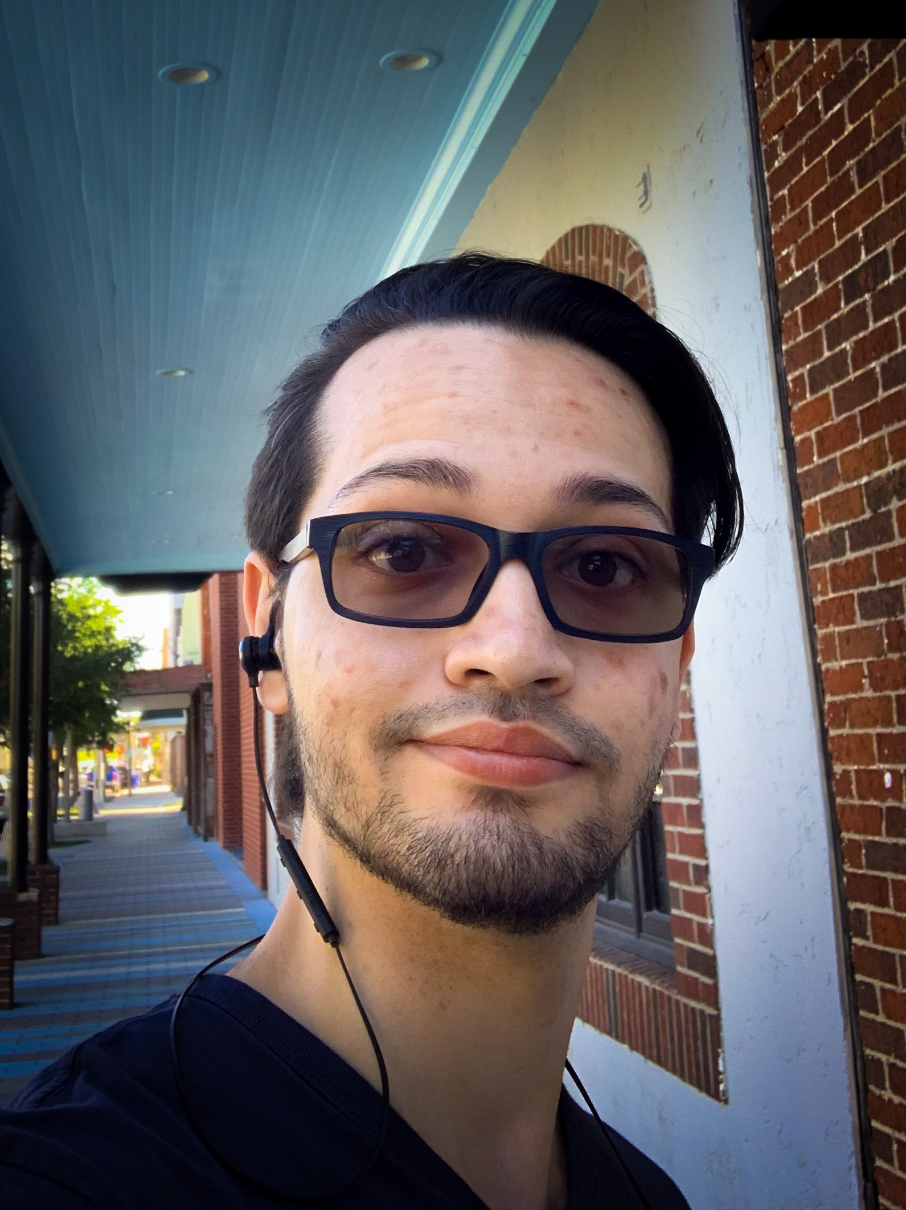
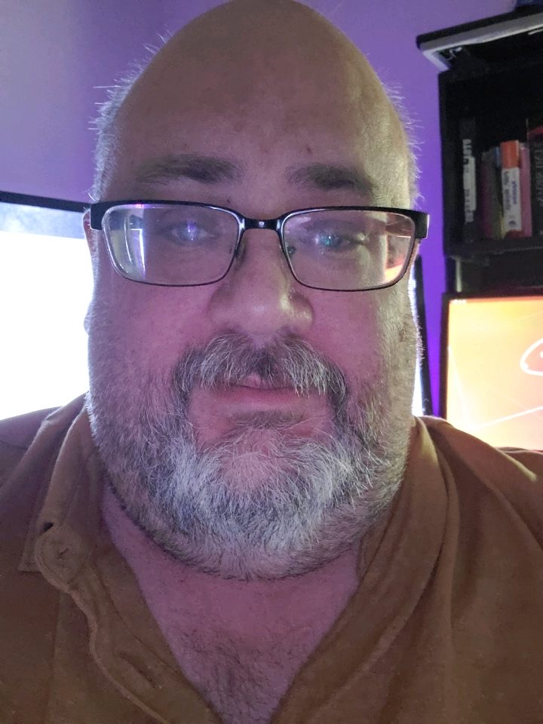
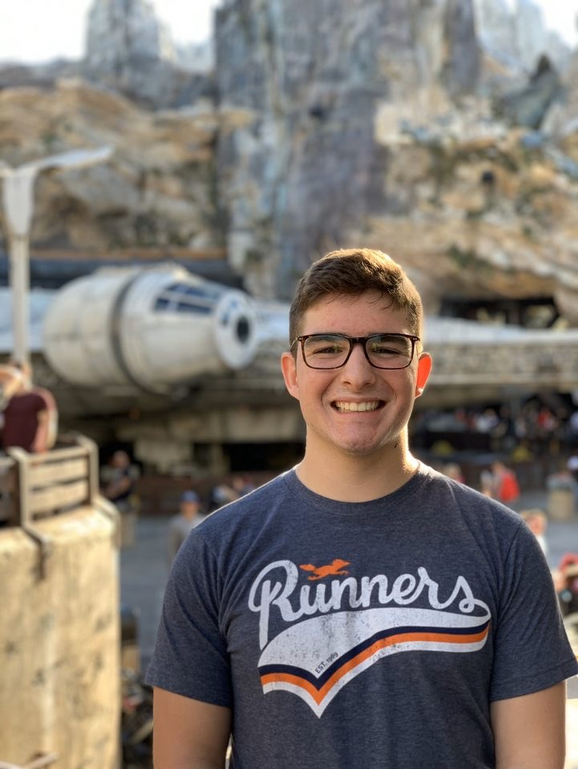
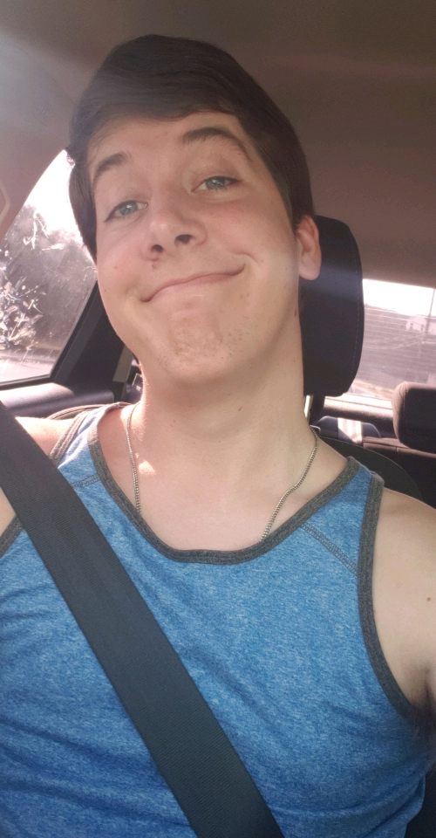
D&D 5E Character Builder
UTSA CS 3443 - 003
Spring 2020
Group 12
Mazen Shaban
Bruce Orcutt
Hunter Johnson
Michael Lawrence

Slide 2
Project Title
Description
Program to build and maintain Dungeons & Dragons characters.
Pitch
Bring all required information and streamline the character-building process in order to improve the ease of play for new players. Maintain the characters in one area and easy process in order to maintain users and attract veteran players
UTSA CS 3443 - 003
Group 12 – D&D CB

Slide 3
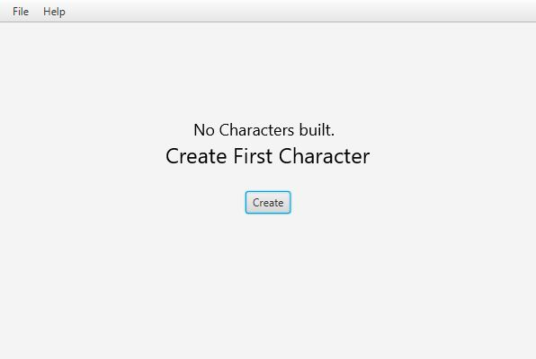
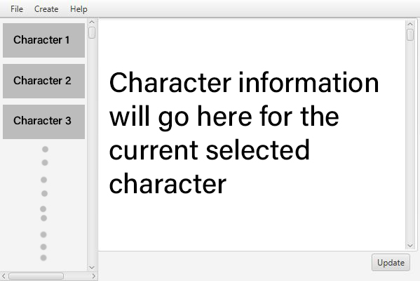
User Interface Design
UTSA CS 3443 - 003
Group 12 – D&D CB

Slide 4
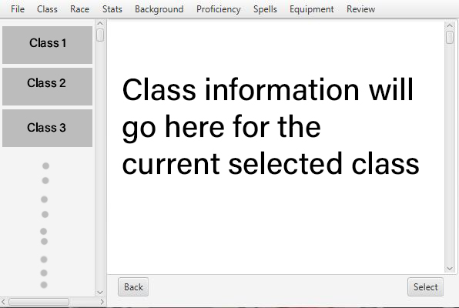
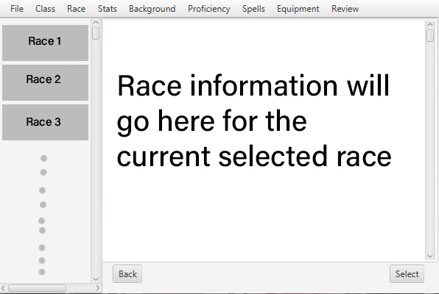
User Interface Design
UTSA CS 3443 - 003
Group 12 – D&D CB

